Slide 1

OBJECT ORIENTED MODELLING & DESIGN (OOMD)
Advanced Algorithm
Surabhi Narayan
Nithin H A
N S Kumar
Department of Computer Science

Slide 2
ADVANCED ALGORITHMS Analysis Framework
Algorithm Analysis: Predicting the resources
that the algorithm requires
Two types of Resources:
Time
Space
Factors contributing to Algorithm Analysis Framework
Input Size
Units for measuring run time
Order of Growth
Worst-Case, Best-Case and Average-Case Efficiencies

Slide 3
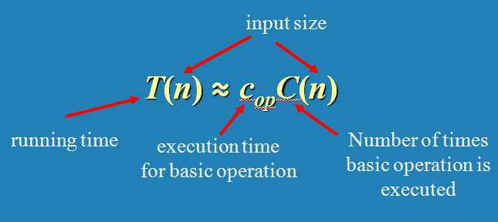
ADVANCED ALGORITHMS BASICS OF COMPLEXITY
Time Efficiency
Counting the number of times the algorithm’s basic operation is executed on inputs of size n

Slide 4
ADVANCED ALGORITHMS BASICS OF COMPLEXITY
Mathematical Analysis of Iterative Algorithms
Find the input size
Identify the basic operation
Count the # of operations by summation
Binary search on linked list?

Slide 5
ADVANCED ALGORITHMS Counting : Some Examples
c <- 0
for i <- 1 to n do
c <- c + 1
----------------
c <- 0
for i <- 1 to n do
c <- c + i

Slide 6
ADVANCED ALGORITHMS Counting : Some Examples
c <- 0
for i <- 1 to n do
c <- c + i * i
----------------
c <- 0
for i <- 1 to n do
c <- c + 1
for j <- 1 to n do
c <- c + 1

Slide 7
ADVANCED ALGORITHMS Counting : Some Examples
c <- 0
for i <- 1 to n do
for j <- 1 to n do
c <- c + 1
----------------
c <- 0
for i <- 1 to n do
for j <- i + 1 to n do
c <- c + 1

Slide 8
ADVANCED ALGORITHMS Counting : Some Examples
c <- 0
for (i <- n; i > 0; i <- floor(i / 2))
c <- c + 1
----------------
c <- 0
for (i <- n; i > 0; i <- floor(i / 2))
for j <- 1 to i do
c <- c + 1

Slide 9
ADVANCED ALGORITHMS Counting : Some Examples
k ← 0
n ← length(str)
for each permutation of str
j ← 1
while (j ≤ n)
k ← k + 1
j ← j + 1

Slide 10
ADVANCED ALGORITHMS Counting : Some Examples
Algo sort(a[0 .. n – 1])
if(n <= 1) return n
flag <- true
for i <- 0 to n – 1 do
if(a[i] > a[i + 1]) then
swap(a[i], a[i + 1])
flag <- false
if flag then return n
sort(a[0 .. n -2])
Worst case : O(n^2)
Best case : O(1) ??

Slide 11
ADVANCED ALGORITHMS Counting : Some Examples
k ← 0
i ← n
while (i > 1)
j ← 1
while (j ≤ n)
k ← k + 1
j ← j + 1
i ← i / 2

Slide 12
ADVANCED ALGORITHMS Counting : Some Examples
k ← 0
i ← n
while (i > 1)
j ← 1
while (j ≤ i)
k ← k + 1
j ← j + 1
i ← i / 2

